Slide 1
Reinforcement Learning
Training Vantage AI

Slide 2
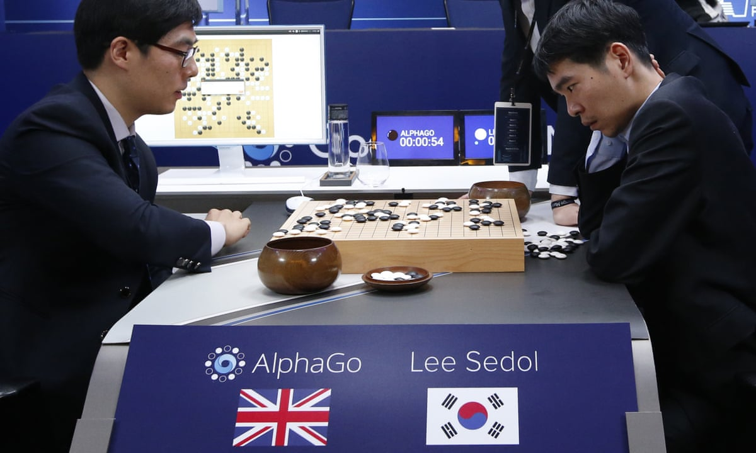

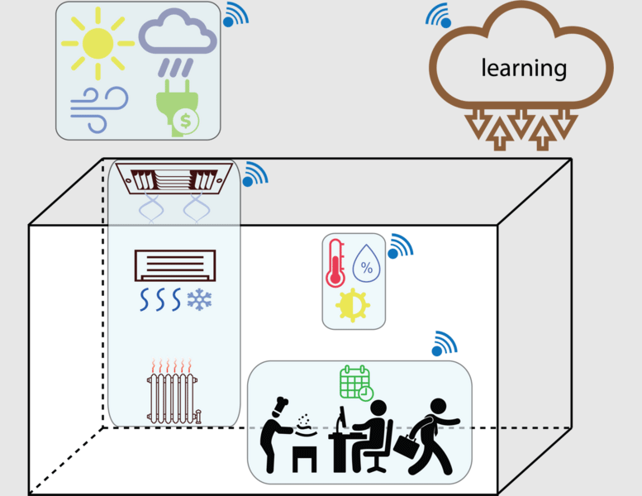
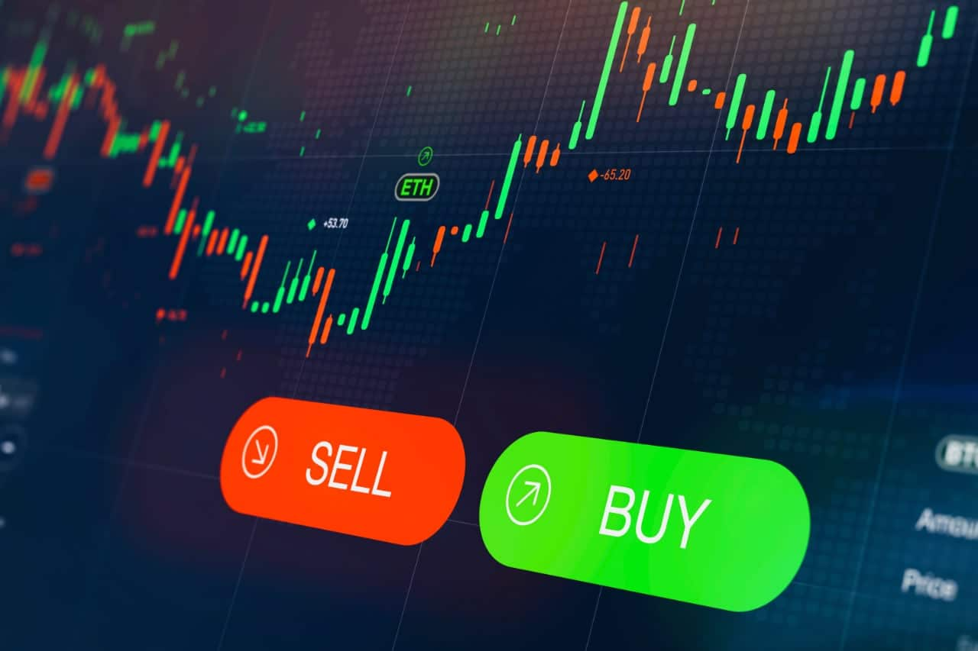
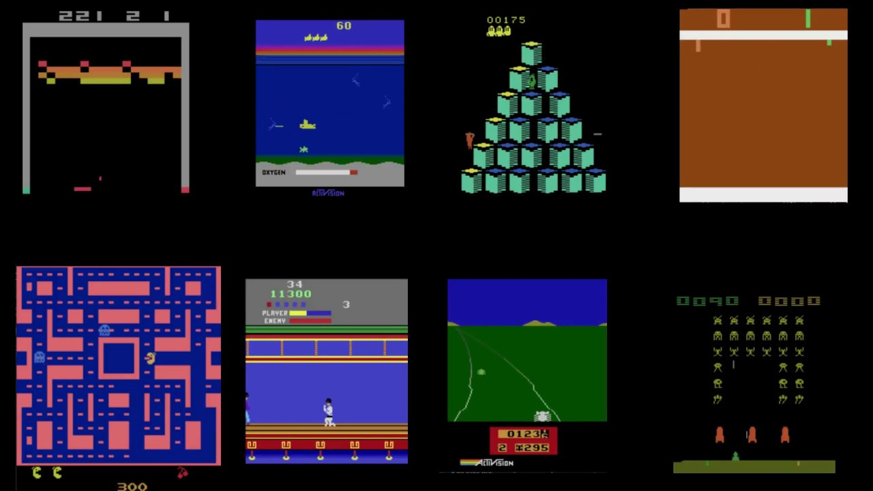
Exciting field…

Slide 3
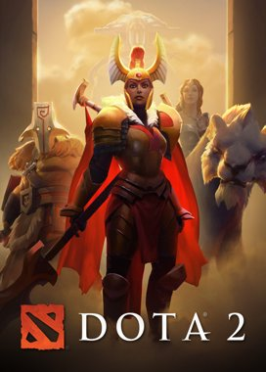
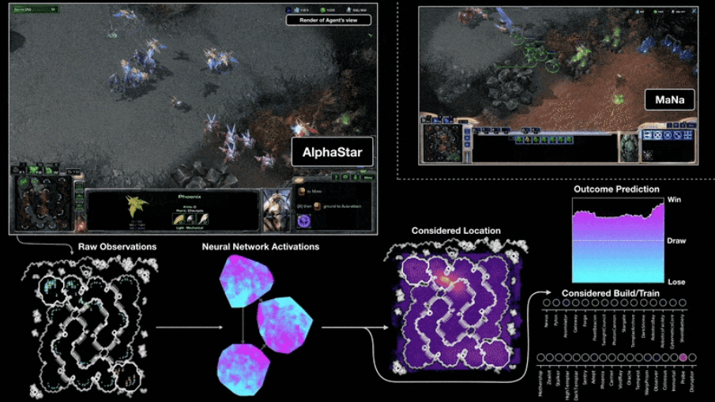
And even more impressive
No single best strategy
Imperfect information
Long term planning
Large action space

Slide 4
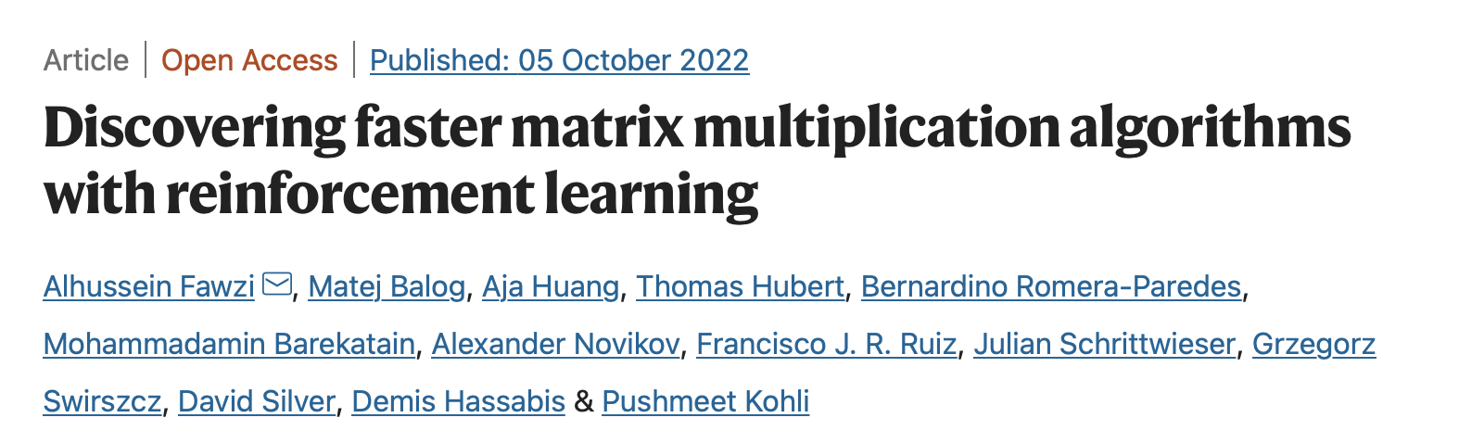
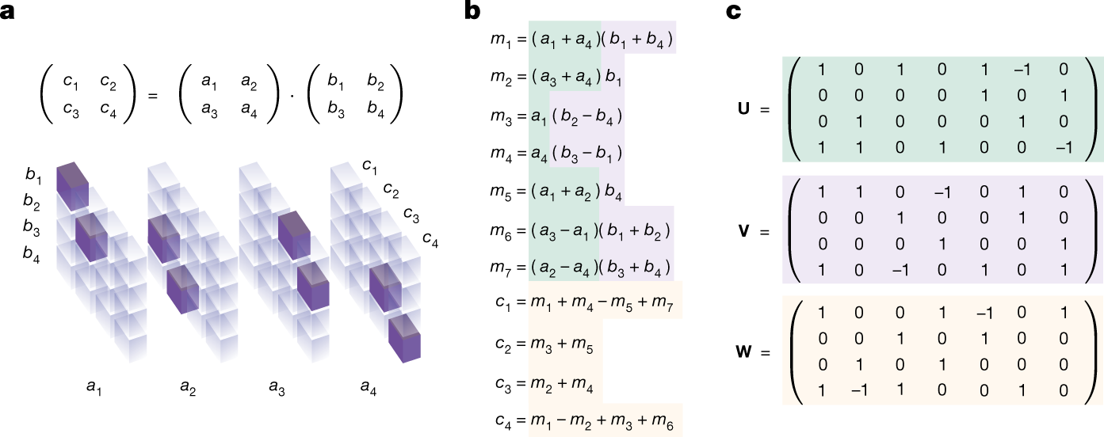

Slide 5
Any other examples?
RL experience?

Slide 6
Agenda
What is RL
Terminology & concepts
When (not) to use RL?
Basic Reinforcement Learning systems
Multi-armed bandits
Markov decision processes
Q-Learning
Hands on 1
Deep Q-Learning
Improving RL systems
Hands on 2
Case: Double Deep Q-Learning at Ikea by Menno
Final thoughts and further reading

Slide 7
What is Reinforcement Learning?

Slide 8
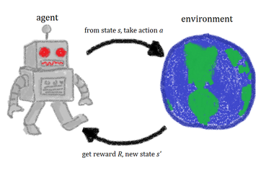
Reinforcement Learning
Learn by trial and error
Agent takes actions
Receives state and rewards (positive and negative)
Adjusts his actions to maximize return (cumulative reward)

Slide 9
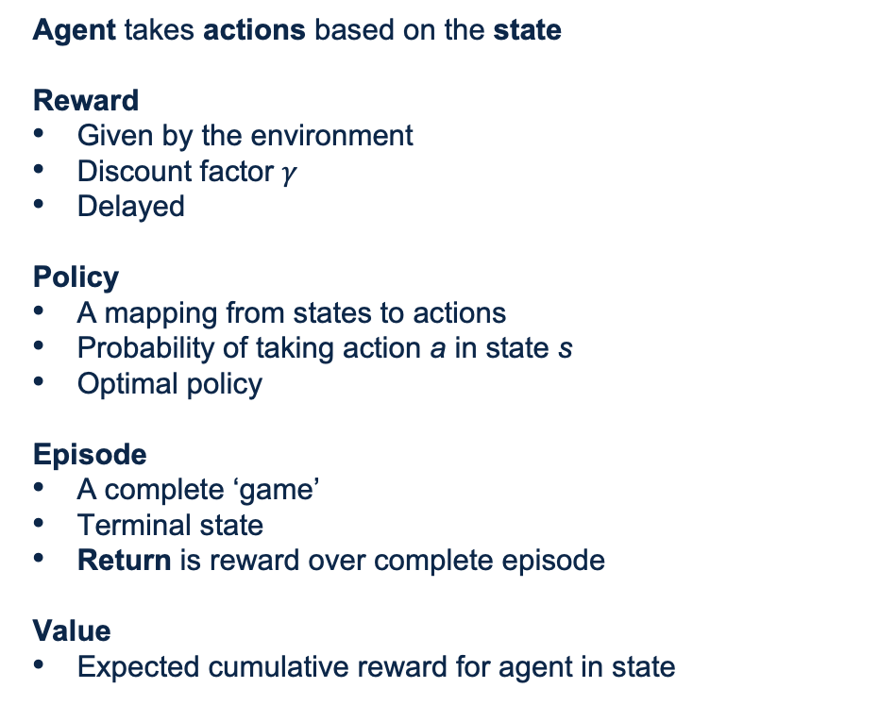
Reinforcement Learning Terminology
Agent takes actions based on the state
Reward
Given by the environment
Discount factor $γ$
Delayed
Policy
A mapping from states to actions
Probability of taking action a in state s
Optimal policy
Episode
A complete ‘game’
Terminal state
Return is reward over complete episode
Value
Expected cumulative reward for agent in state
Notes:
On-policy: SARSA, take actions based on your current policy; Off-policy: Q-learning, take different actions (for example random, no policy needed)

Slide 10
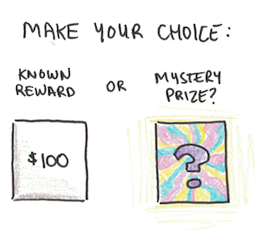
Exploit or Explore?
Notes:
https://www.scotthyoung.com/blog/2019/09/17/explore-exploit/

Slide 11
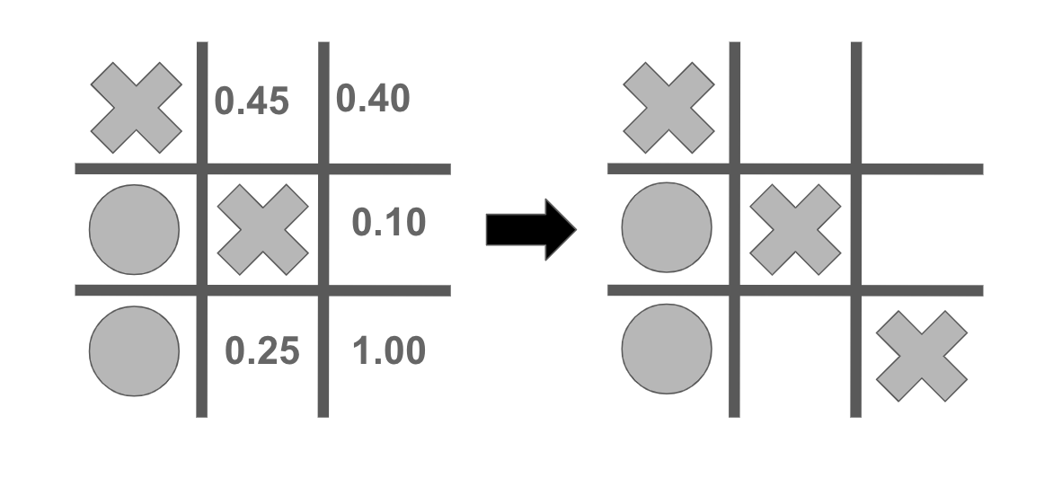
Reinforcement Learning Example
Tic Tac Toe
Actions?
State?
Rewards?
[cross, empty, empty, circle, cross, empty, circle, empty, empty]

Slide 12
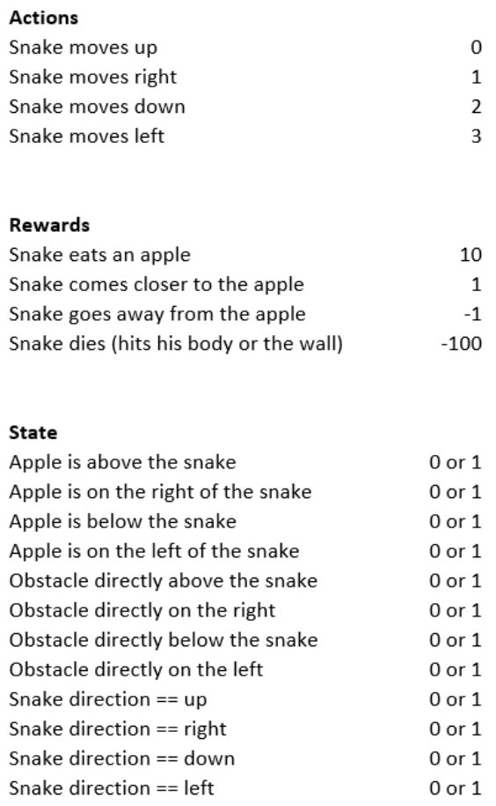
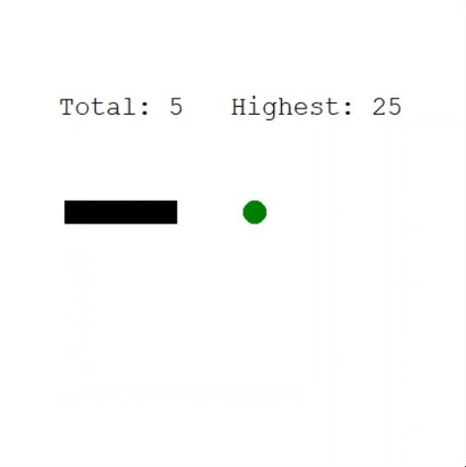
Snake RL Agent
How would you define actions, rewards and state for the game Snake?

Slide 13
Snake Demo
How many games does the agent need to learn how to play the game?

Slide 14
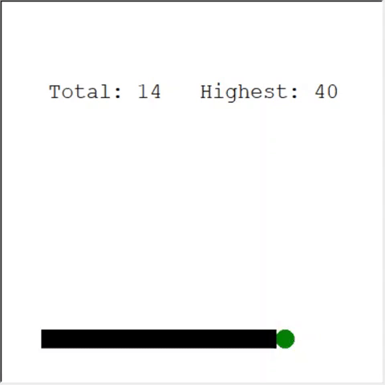
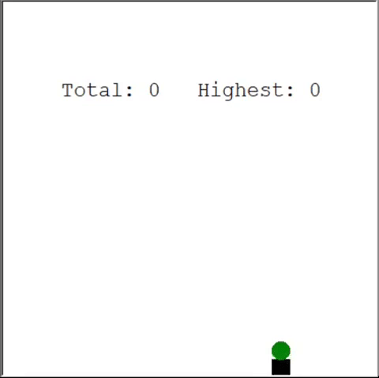
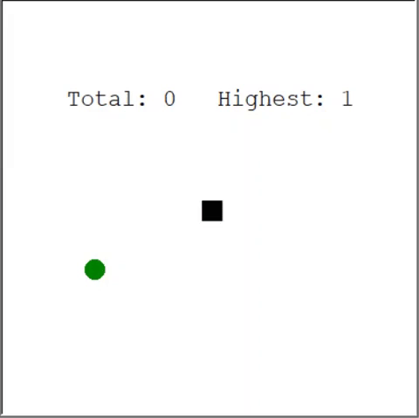
Snake Take Aways
Importance of the state space
Drawback of coordinates
Will the agent learn how to play perfectly with this state space?
Bloopers
Reward 1 for every timestep
Reward -1 for every timestep
A small neural network is enough (3 hidden layers, 128 neurons)
Experience replay helped (a lot)

Slide 15
Reinforcement Learning Challenges
“Whenever someone asks me if reinforcement learning can solve their problem, I tell them it can’t. I think this is right at least 70% of the time.” – Alexander Irpan
RL needs MANY samples: problem in real life
RL gets beaten by other methods
Rewards: shaped and delayed
Inpredictable behaviour
Generalization issues
Noisy and unstable
Notes:
Samples: Playing time Rainbow Net Atari: 83 hours Playing time StarCraft: 200 years of realtime StarCraft play
Other methods: monte carlo tree search (Atari), robotics (online trajectory optimization)
Shaped: biased learning and weird things can happen, Delayed: hard to learn
Generalization: trained on one Atari game, can’t play other games, And: learn to play to an optimal player, other players are hard.
Noisy: many hyperparameters to tune, randomization doesn’t guarantee results, not reproducible, not guaranteed to get good results every time
https://www.alexirpan.com/2018/02/14/rl-hard.html

Slide 16
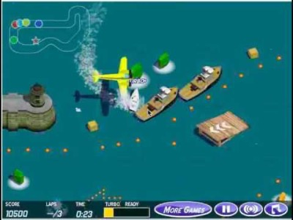

Slide 17
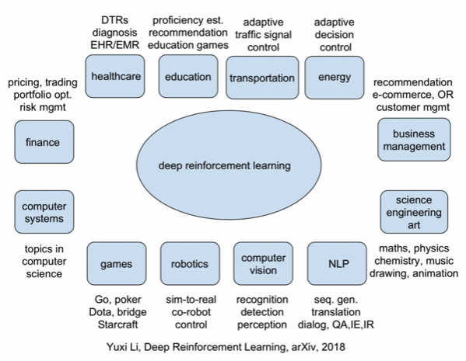
Reinforcement Learning Use Cases
https://www.v7labs.com/blog/reinforcement-learning-applications
Notes:
It’s hard to find real world productionized Deep RL use cases.
Google: reducing data center power usage
AutoML vision effort

Slide 18
Basic Reinforcement Learning Systems
Multi-armed bandits, Markov decision processes and Q-Learning

Slide 19
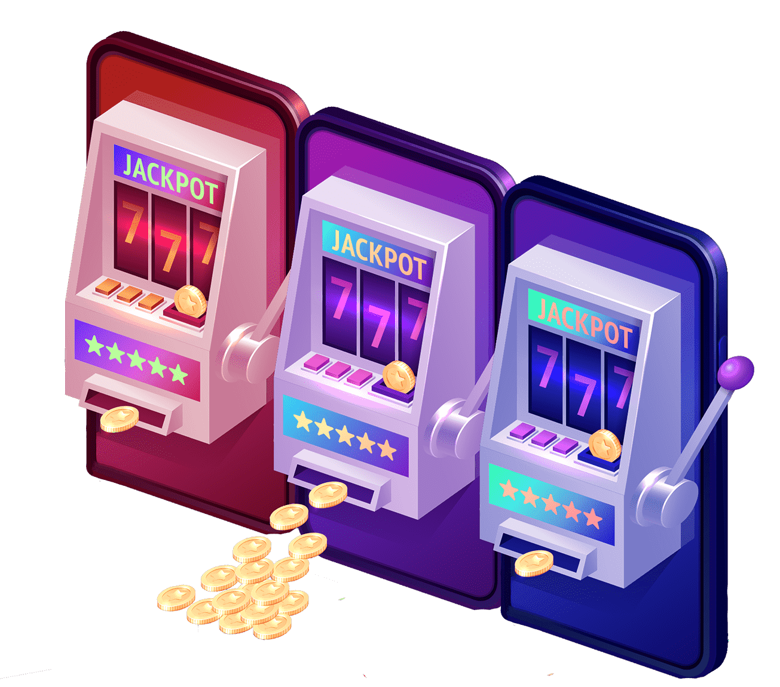
Multi-Armed Bandit Problems
The easiest (?) RL systems, but still useful

Slide 20
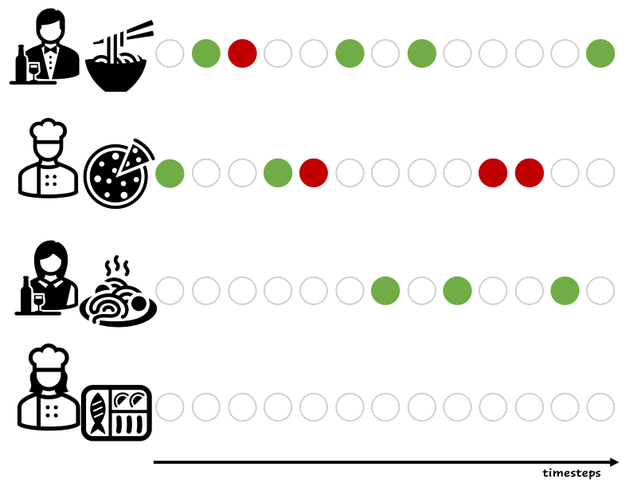
What are Multi-Armed Bandits?
For every timestep, select the ‘best’ action
Maximize return, minimize regret
Acquire knowledge
Explore and exploit
Learn a policy

Slide 21
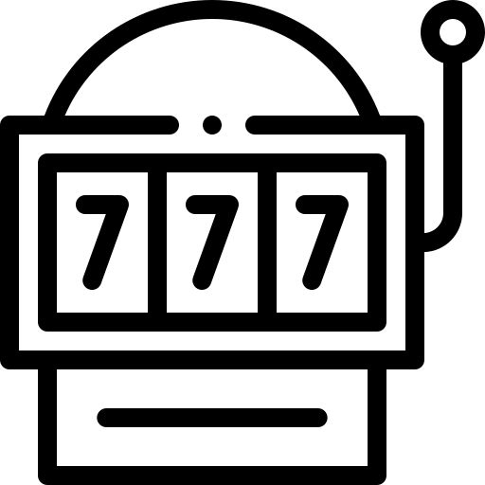
Multi-Armed Bandits Example
Probabilities for the slot machines
0.20
0.31
0.12
0.35
The optimal action is the action with the highest probability

Slide 22
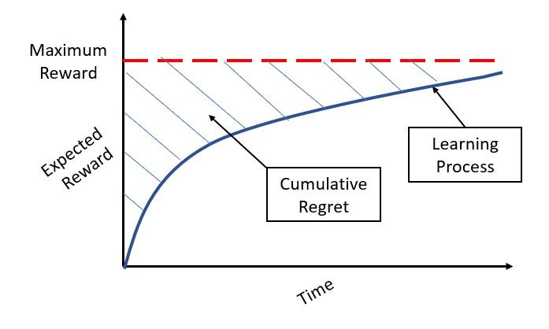
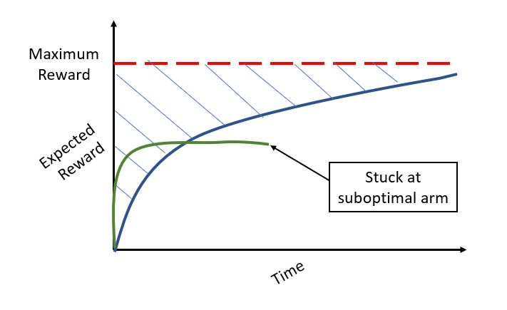
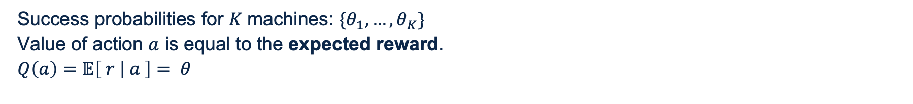
Action-Value Function & Regret
Success probabilities for $K$machines: $\{θ_{1}, …, θ_{K}\}$
Value of action $a$ is equal to the expected reward.
$Q\left(a\right)=𝔼\left[ r | a \right]= θ$

Slide 23


Solving Strategies
random agent
Finding the optimal policy
Baseline: random agent
Best: optimal agent
0.33
0.33
0.33
1.00
0.16
0.21
0.65
optimal agent

Slide 24

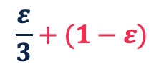
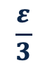
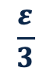
Solving Strategies
epsilon greedy agent
Finding the optimal policy
No exploration
Greedy
Random exploration
Epsilon greedy
Epsilon with decay
Optimistic greedy
Smart exploration
Upper confidence bound
Bernoulli Thompson sampling
If this slot machine has the current highest average reward
$$\frac{ε}{3}$$
$$\frac{ε}{3}+(1−ε)$$
$$\frac{ε}{3}$$
0.16
0.21
0.65
Notes:
https://lilianweng.github.io/posts/2018-01-23-multi-armed-bandit/
Optimistic greedy: suppose rewards are max for all bandits at the beginning, and update with real rewards, more explored in the beginning

Slide 25
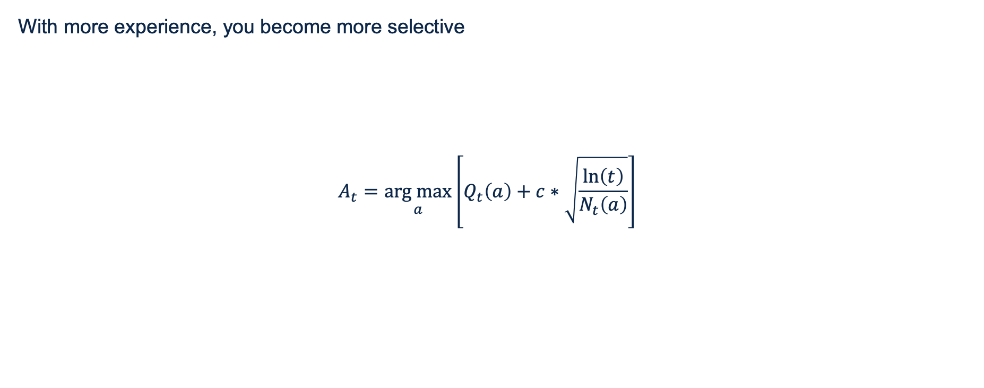
Upper Confidence Bound
With more experience, you become more selective
$$A_{t}=\underset{a}{arg max}\left[Q_{t}\left(a\right)+c∗\sqrt{\frac{\ln\left(t\right)}{N_{t}\left(a\right)}}\right]$$
Exploitation: use the average reward for every action
Exploration: use the number of times the action is selected and the current time step
Notes:
With more experience, you become more selective, preference for actions that aren’t chosen

Slide 26
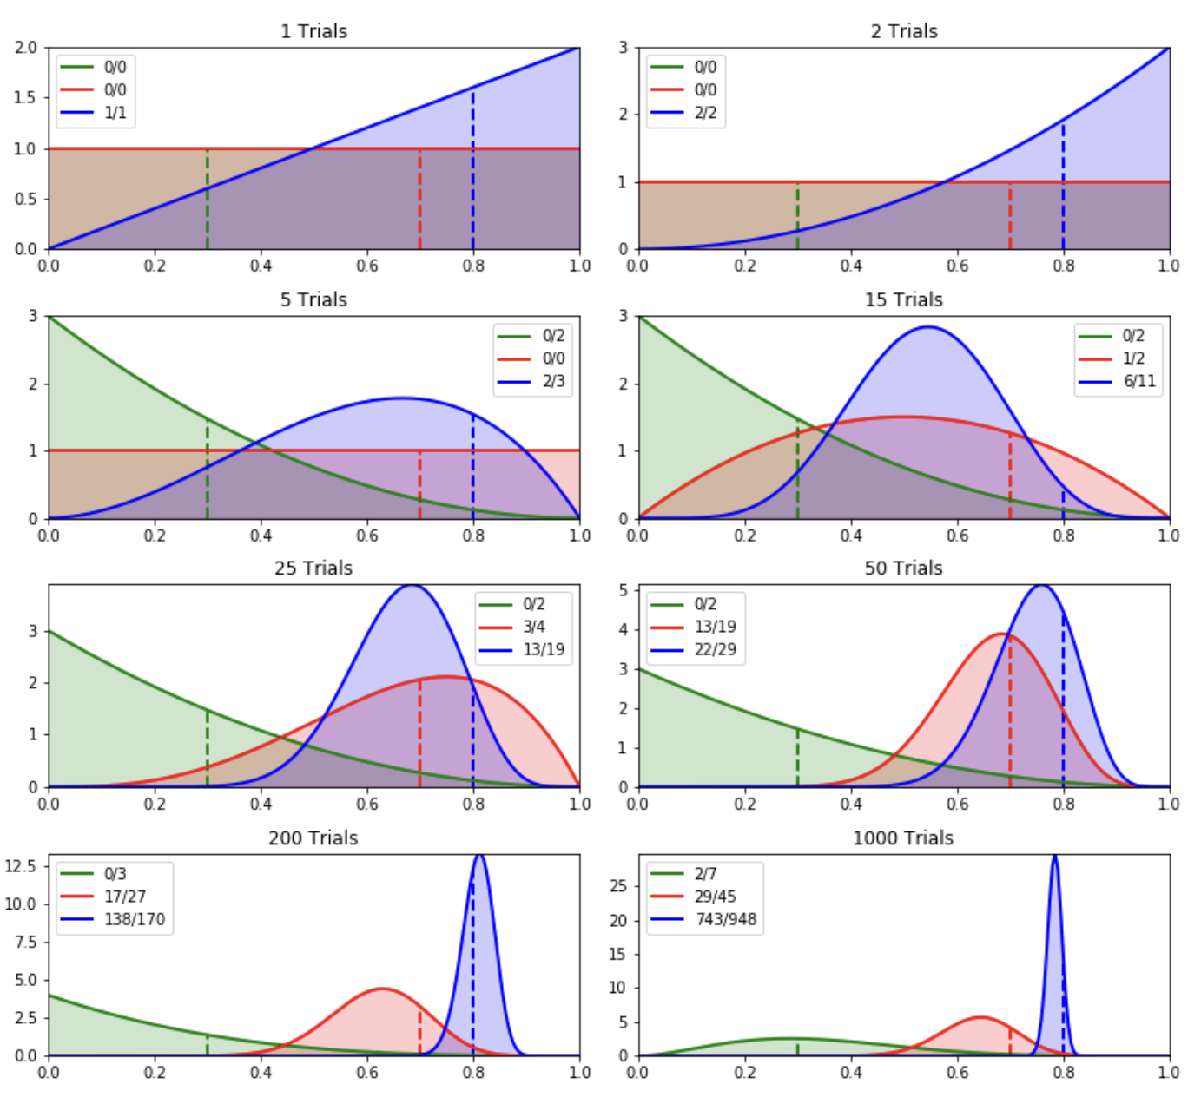
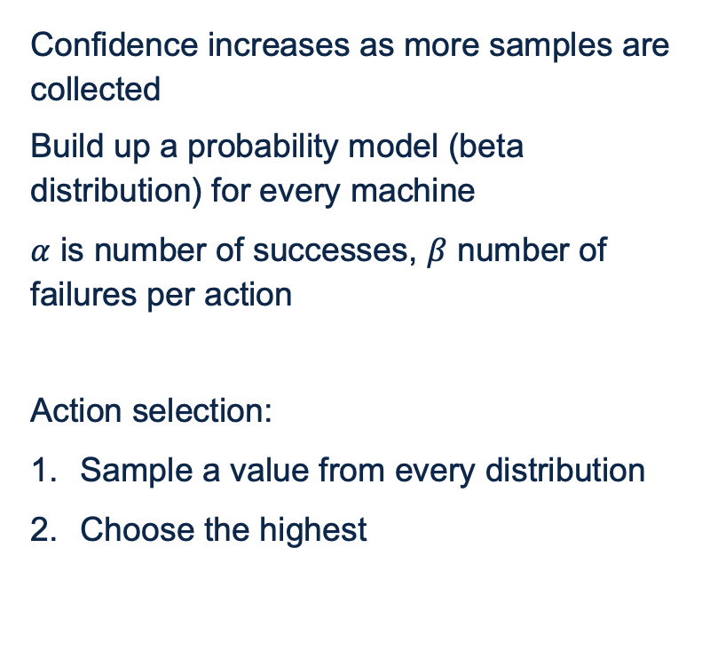
Thompson sampling
Confidence increases as more samples are collected
Build up a probability model (beta distribution) for every machine
$α$ is number of successes, $β$ number of failures per action
Action selection:
Sample a value from every distribution
Choose the highest
Notes:
Sample from the probability distributions, the highest value becomes the action

Slide 27
Shortcomings
Static environment
No state transitions
Actions are a single choice
Usually a fixed and finite set of choices
Optimal policy
Always choose the best arm

Slide 28
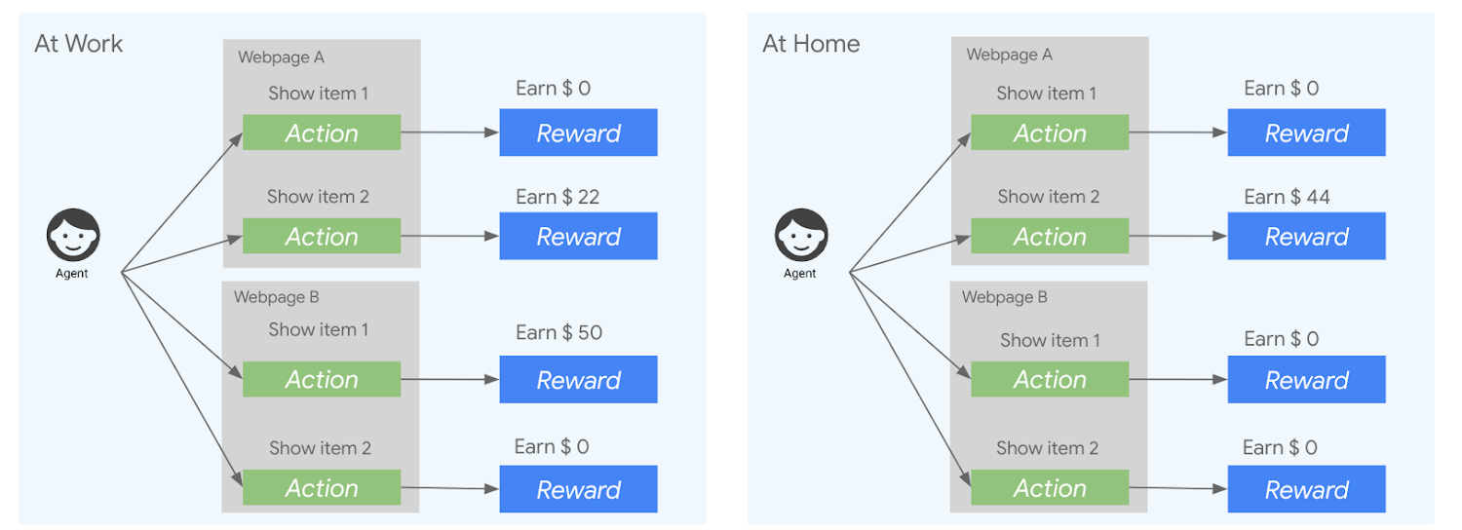
Upgrade: Contextual Bandits
Add some context
Reward is conditional to state of environment

Slide 29
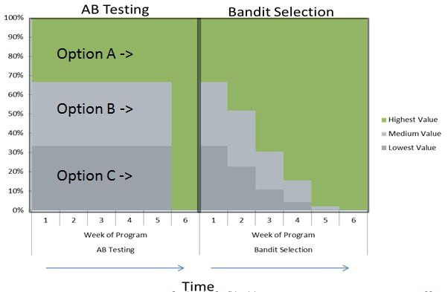
Multi-Armed Bandits Use Cases
Ad Selection
Notes:
Examples: explore the ad that works best. Place add > click is success, highest reward is highest number of clicks.

Slide 30
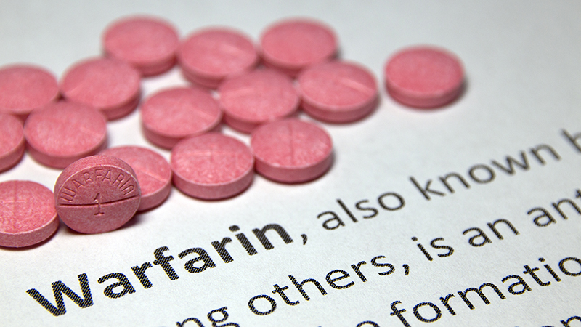
Multi-Armed Bandits Use Cases
Clinical Trials
Notes:
Examples: deciding the correct dosage for medication using patient data, instead of risky fixed dosages that are risky.

Slide 31

Multi-Armed Bandits Use Cases
Recommender Systems
Notes:
Examples: recommend different products > reward is click/chart/buy > similarity between customers, etc.

Slide 32

Multi-Armed Bandits Use Cases
Better Machine Learning
Algorithm selection
Hyperparameter optimization
Clustering
…
Notes:
Examples: improvement over Bayesian optimization, feature selection

Slide 33
Machine 0
Machine 1
Machine 2
0.16
0.21
0.65

Slide 34
Hands-on 1: MAB Agents
git clone https://github.com/BigDataRepublic/vantage-ai-rl-training.git
Implement different agents in the mabpagents.py file (start from epsilon_greedy_agent)
Visualize your results with the mabp.ipynb notebook
Try to maximize the cumulative reward!

Slide 35
Reinforcement Learning part 2
Training Vantage AI

Slide 36
Recap
Agent, states, actions, rewards, policy
Defining actions, states and rewards
RL challenges
Multi-armed bandits
Exploration and exploitation

Slide 37
Agenda
What is RL
Terminology & concepts
When (not) to use RL?
Basic Reinforcement Learning systems
Multi-armed bandits
Markov decision processes
Q-Learning
Hands on 1
Deep Q-Learning
Improving RL systems
Hands on 2
Case: Double Deep Q-Learning at Ikea by Menno
Final thoughts and further reading

Slide 38
Markov Decision Processes

Slide 39
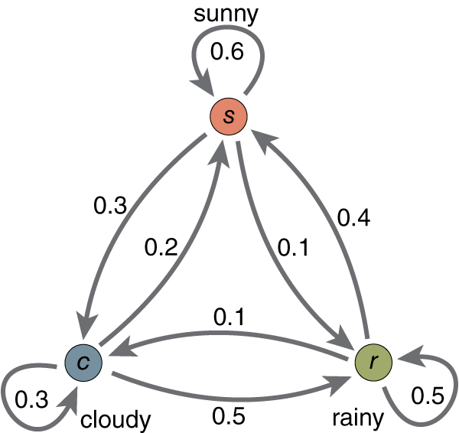
Markov Chains
States with probabilities

Slide 40
Markov Decision Processes
Changes compared to Markov chain
Add actions
Add rewards
1.0
+40
0.8
a₁
0.1
a₁
0.1
0.2
1.0
-50
s₀
a₂
s₁
a₂
s₂
0.8
+10
a₀
a₀
0.3
0.7
1.0
What’s the best strategy here?

Slide 41
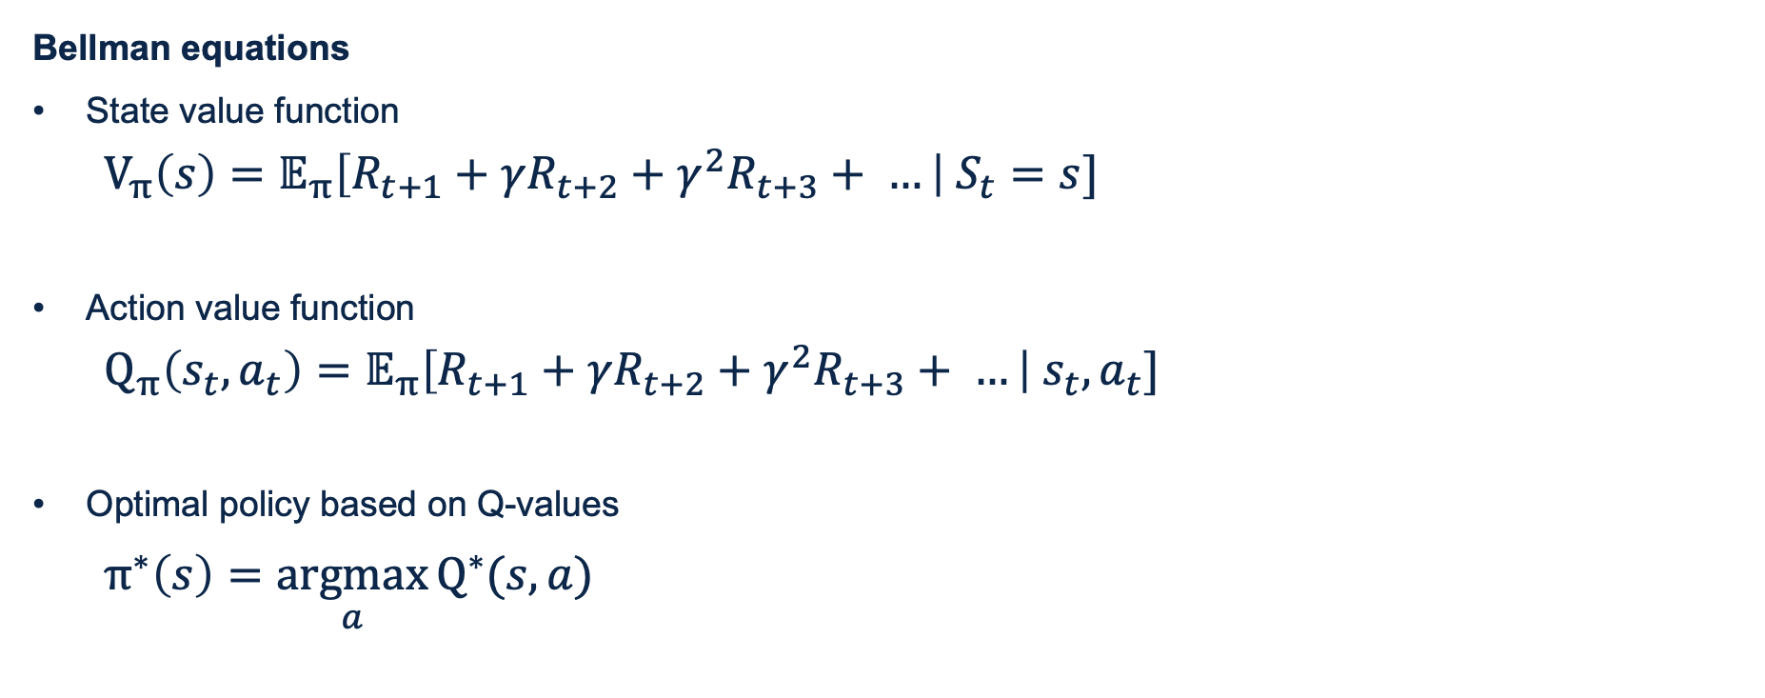
Markov Decision Processes
Bellman equations
State value function
$V_{π}\left(s\right)=𝔼_{π}\left[R_{t+1}+γR_{t+2}+γ^{2}R_{t+3}+ …\right| S_{t}=s]$
Action value function
$Q_{π}\left(s_{t},a_{t}\right)=𝔼_{π}\left[R_{t+1}+γR_{t+2}+γ^{2}R_{t+3}+ …\right|{ s}_{t},a_{t}]$
Optimal policy based on Q-values
$π^{∗}\left(s\right)=\underset{a}{argmax}{Q^{∗}(s,a)}$
Notes:
Q-values = quality values
Q-value of a (s,a) pair is the sum of discounted future rewards the agent can expect on average after it reaches state s and chooses action a (assuming it acts optimally after that action)

Slide 42
Q-Learning

Slide 43
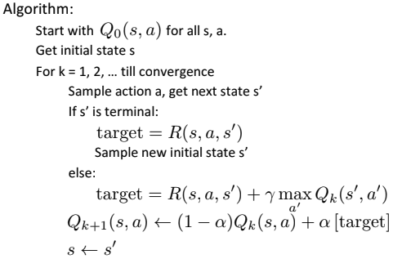
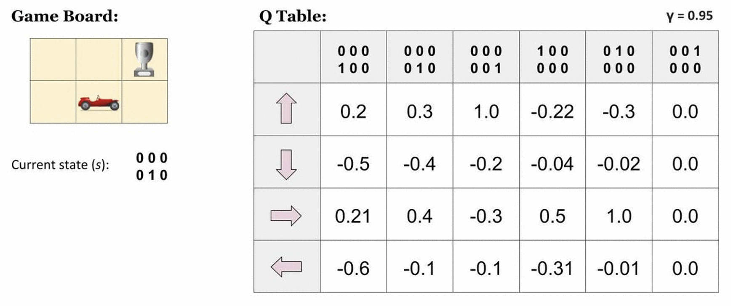
Tabular Q-Learning Algorithm

Slide 44
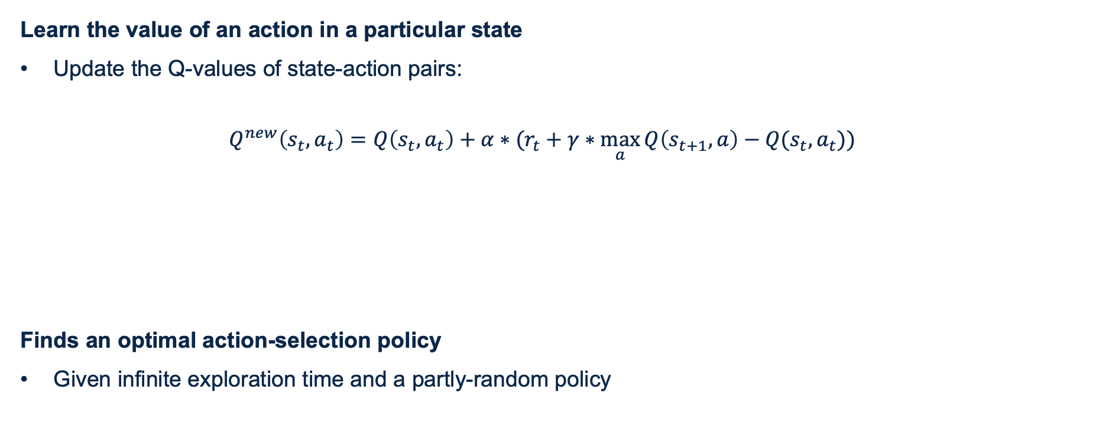
Q-Learning
Learn the value of an action in a particular state
Update the Q-values of state-action pairs:
$$Q^{new}\left(s_{t},a_{t}\right)=Q\left(s_{t},a_{t}\right)+α∗(r_{t}+γ∗\max_{a}{Q\left(s_{t+1},a\right)−Q(s_{t},a_{t}))}$$
Finds an optimal action-selection policy
Given infinite exploration time and a partly-random policy
temporal difference
current value
reward
maximum expected future reward

Slide 45
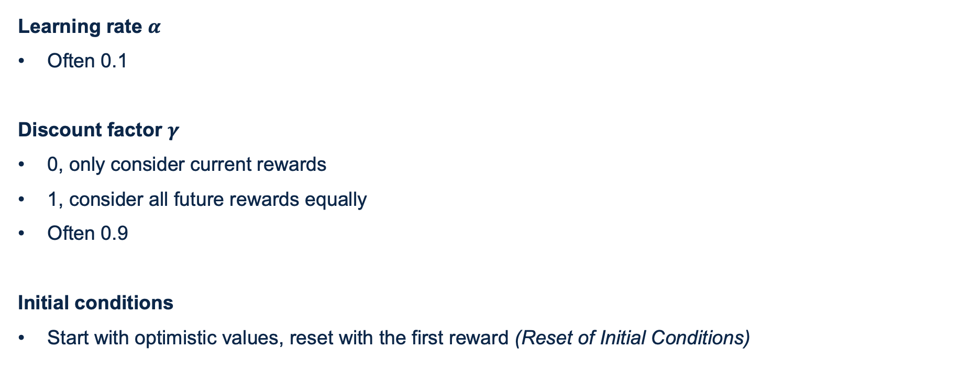
Q-Learning Parameters
Learning rate $α$
Often 0.1
Discount factor $γ$
0, only consider current rewards
1, consider all future rewards equally
Often 0.9
Initial conditions
Start with optimistic values, reset with the first reward (Reset of Initial Conditions)
$$Q^{new}\left(s_{t},a_{t}\right)=Q\left(s_{t},a_{t}\right)+α∗(r_{t}+γ∗\max_{a}{Q\left(s_{t+1},a\right)−Q(s_{t},a_{t}))}$$

Slide 46
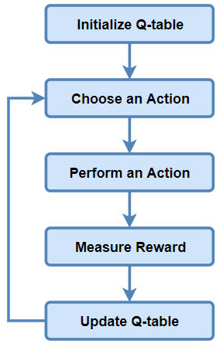
Q-Learning Basic: Q-Table
State-action table

Slide 47
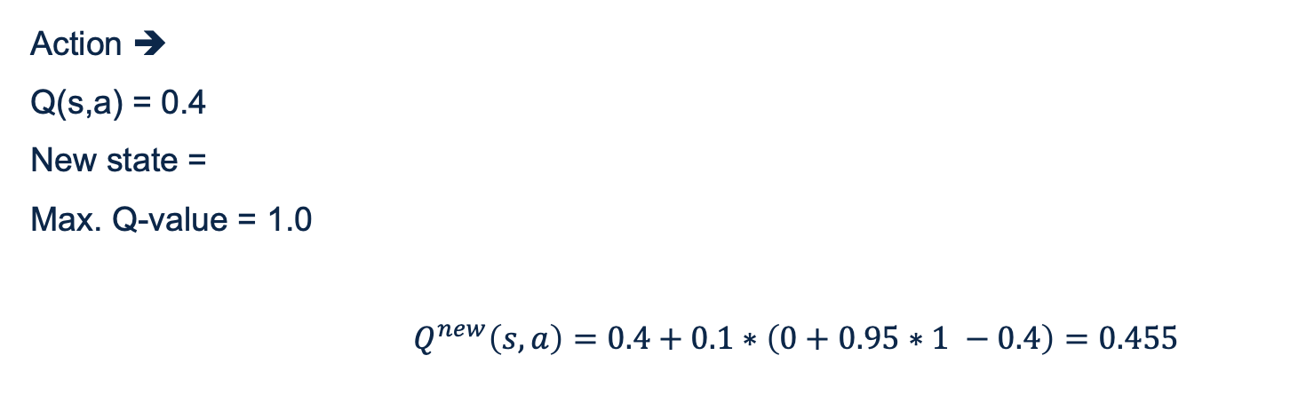
Q-Learning Example: Q-Table
$$Q^{new}\left(s_{t},a_{t}\right)=Q\left(s_{t},a_{t}\right)+α∗(r_{t}+γ∗\max_{a}{Q\left(s_{t+1},a\right)−Q(s_{t},a_{t}))}$$
Action ➔
Q(s,a) = 0.4
New state =
Max. Q-value = 1.0
$Q^{new}\left(s,a\right)=0.4+0.1∗\left(0+0.95∗1 −0.4\right)=0.455$

Slide 48
Q-Learning
Off-policy learning
The policy trained is not the policy being executed
Different policies possible
Random policy (can be slow)
Epsilon greedy policy
Encourage exploration on action it hasn’t tried much before
Notes:
Random policy (can take extremely long with a large state-action space)
Epsilon greedy policy (spends more time investigating interesting parts of the environment)

Slide 49
Q-Learning Issues
You have to explore enough, and decrease learning rate in the right way (not too fast/slow)
Q-Learning has a problem with scale
Many states and actions: hard to keep track of every single Q-value
Q-Learning only works with discrete state and action spaces
Solution 1: Approximate Q-Learning
Solution 2: Deep Q-Learning ☺
Notes:
Approximate Q-learning: use a function that approximates the Q-value of any state-action pair. (Shrink the number of Q-values) :( handcrafted features extracted from the state
https://www.quora.com/What-are-the-pros-and-cons-of-doing-Q-learning

Slide 50
Deep Q-Learning

Slide 51
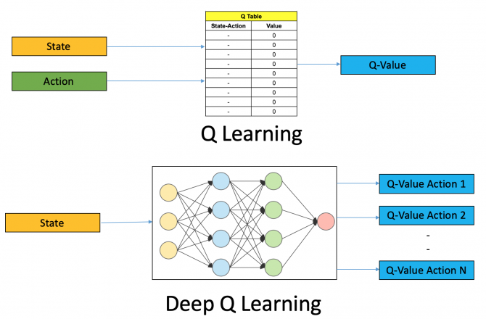
Deep Q-Learning Intuition
Replace the Q-Learning table with a neural network
The NN works as a function approximator
Notes:
Function approximator = necessary for complex/big environments

Slide 52
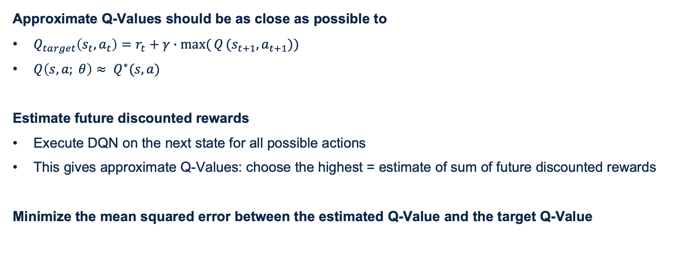
Training the DQN
Approximate Q-Values should be as close as possible to
$Q_{target}\left(s_{t},a_{t}\right)=r_{t}+γ∙max⁡({Q}(s_{t+1}, a_{t+1}))$
$Q\left(s, a; θ\right)≈ Q^{∗}(s,a)$
Estimate future discounted rewards
Execute DQN on the next state for all possible actions
This gives approximate Q-Values: choose the highest = estimate of sum of future discounted rewards
Minimize the mean squared error between the estimated Q-Value and the target Q-Value
Notes:
MSE estimated & target is loss function

Slide 53
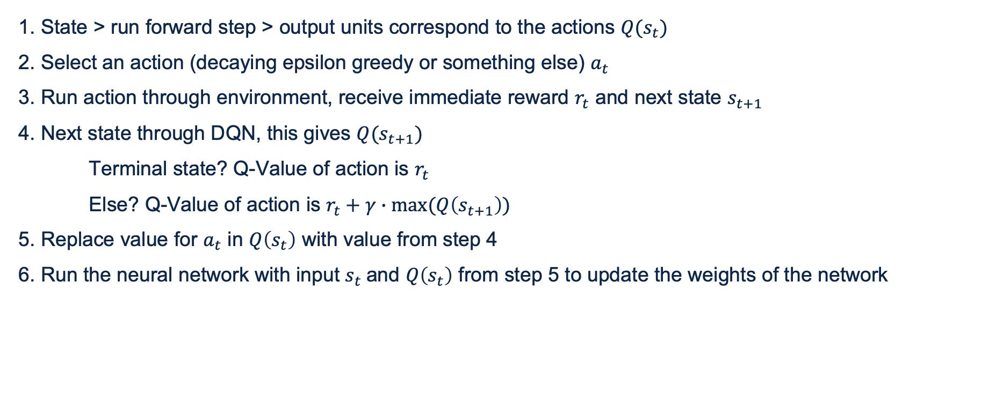
Training step of the DQN
1. State > run forward step > output units correspond to the actions $Q(s_{t})$
2. Select an action (decaying epsilon greedy or something else) $a_{t}$
3. Run action through environment, receive immediate reward $r_{t}$ and next state $s_{t+1}$
4. Next state through DQN, this gives $Q(s_{t+1})$
Terminal state? Q-Value of action is $r_{t}$
Else? Q-Value of action is $r_{t}+γ∙max⁡(Q\left(s_{t+1}\right))$
5. Replace value for $a_{t}$ in $Q\left(s_{t}\right)$ with value from step 4
6. Run the neural network with input $s_{t}$and $Q\left(s_{t}\right)$ from step 5 to update the weights of the network

Slide 54
Improving RL Systems
Experience Replay, Double DQRL, Dueling Architectures, Distributional RL, Noisy Networks

Slide 55
Reinforcement Learning Challenges
“Supervised learning wants to work, reinforcement learning must be forced to work.” – Andrej Karpathy
RL needs MANY samples: problem in real life
RL gets beaten by other methods
Rewards: shaped and delayed
Inpredictable behaviour
Generalization issues
Noisy and unstable
Notes:
Noisy: huge sensitivity to the choice of hyperparameter values and even random seeds.

Slide 56

Delayed Rewards
Episodic or sparse rewards
Happens often
Possible solutions
If possible, add small rewards to ‘inbetween goals’, give the agent a direction
RUDDER: decomposes delayed and sparse reward to surrogate per-step rewards via regression
HC decomposition framework: decompose value function into history and current information
Curiosity-based exploration: seeks situations where the outcome doesn’t match its predictions

Slide 57

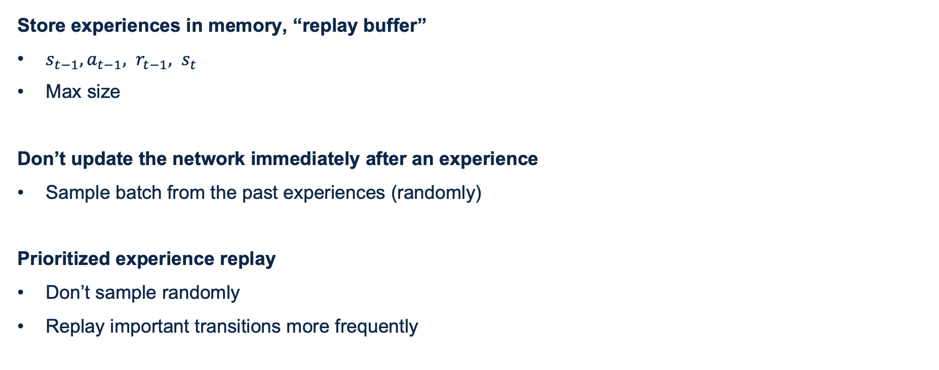
Experience Replay
Store experiences in memory, “replay buffer”
$s_{t−1}, a_{t−1}{, r}_{t−1}, s_{t}$
Max size
Don’t update the network immediately after an experience
Sample batch from the past experiences (randomly)
Prioritized experience replay
Don’t sample randomly
Replay important transitions more frequently
Notes:
Advantages: efficient use of previous experience, by learning from it multiple times. Speeds up learning process
Tackles the problem of autocorrelation leading to unstable training

Slide 58
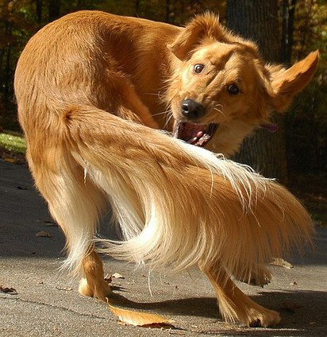
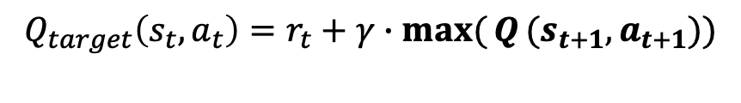
Double Deep Q-Learning
Problem: Maximization bias
$$Q_{target}\left(s_{t},a_{t}\right)=r_{t}+γ∙max⁡({Q}(s_{t+1}, a_{t+1}))$$
Take the max Q-value of the next state (estimates)
If the network overestimates the action-values, this can lead to unstable training and a low-quality policy
Notes:
Problem: the DQN learns estimates from estimates. This can cause maximization bias (taking the maximum overestimated values).

Slide 59
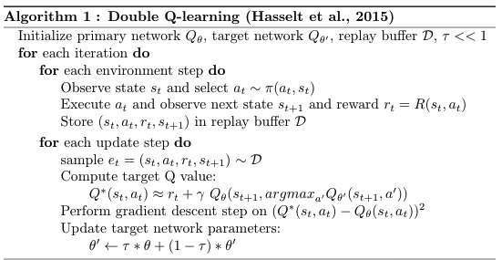
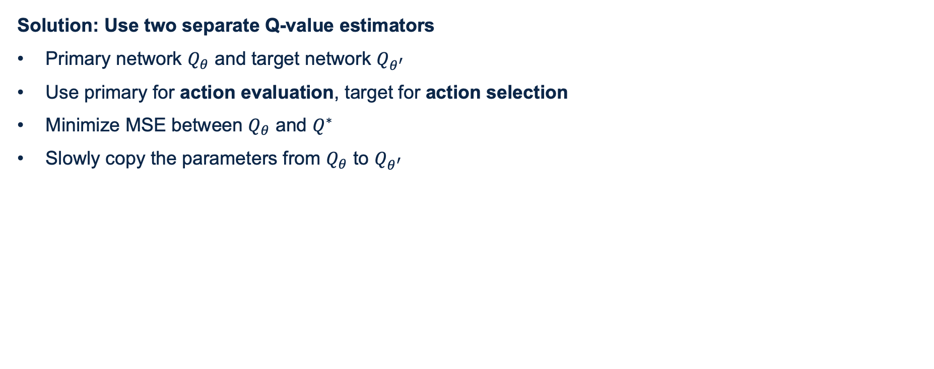
Double Deep Q-Learning
Solution: Use two separate Q-value estimators
Primary network $Q_{θ}$ and target network $Q_{θ^{′}}$
Use primary for action evaluation, target for action selection
Minimize MSE between $Q_{θ}$ and $Q^{∗}$
Slowly copy the parameters from $Q_{θ}$ to $Q_{θ^{′}}$
Notes:
Another improvement: Clipped Double Q-Learning: take the minimum of the two next-state action values produced by the two Q networks, this avoids overestimation.

Slide 60

Double Deep Q-Learning
Results

Slide 61

Dueling Architecture
Recap:
State value function
$v_{π}\left(s\right)=𝔼_{π}\left[R_{t+1}+γR_{t+2}+γ^{2}R_{t+3}+ …\right| S_{t}=s]$
Action value function
$Q_{π}\left(s_{t},a_{t}\right)=𝔼_{π}\left[R_{t+1}+γR_{t+2}+γ^{2}R_{t+3}+ …\right|{ s}_{t},a_{t}]$
New:
Advantage
$A\left(s_{t},a_{t}\right)=Q\left(s,a\right)−V\left(s\right)$
Notes:
What’s the advantage of taking this action in this state over the other actions?

Slide 62

Dueling Architecture
Separate: state values and action advantages to estimate the action-value function
For some use cases, it is unnecessary to know the value of each action at every timestep
Advantages
Detect (not) valuable states
Actions might not always affect the environment in meaningful ways
Notes:
Some states are (not) valuable, the effect of each action isn’t important
Relevant when actions might not always affect the environment in meaningful ways

Slide 63


Actor-Critic algorithms
Value based
Policy: $\underset{a}{argmax}{Q(s,a)}$
Deterministic and sensitive
Policy based
Train model to predict probabilistic policy

Slide 64


Actor-Critic algorithms
Combine Policy Gradients with DQN
2 neural networks
Policy net
DQN

Slide 65

Actor-Critic algorithms
Other flavours
Advantage Actor-Critic (A2C)
Asynchronous Advantage Actor-Critic (A3C)
Notes:
Advantage: use advantage to encourage actor to take more/less of an action
Multiple agents contributing to the knowledge of the global network.

Slide 66
Distributional Reinforcement Learning
Work directly with the full distribution of returns for a state-action pair (instead of its expectation)
Minimize distributional error (distance between full distributions)
Disdvantage
Makes the algorithm more complex
Can reduce performance
Advantage
Can be an advantage in exploration, can give the agent more information
Leads to more stable learning
Notes:
Expectation = one value

Slide 67

Noisy Networks
Add parametric noise to the weights and biases
Improves efficient exploration
Notes:
Replace w and b with …
Mu and sigma are learnable, epsilon is the noise (element-wise multiplication)

Slide 68

Putting it all together: Rainbow DQN
Combining six improvements
Double DQN
Prioritized DDQN
Dueling DDQN
A3C
Distributional DQN
Noisy DQN
Notes:
Fun fact: 18 million frames to reach human level performance (83 hours of play experience), 60 frames per second

Slide 69
Hands-on 2: Formula-V
Create a RL agent that plays Formula-V
Demo

Slide 70
Current settings
Actions, rewards, state
Actions: left, right, do nothing
Rewards: -1 if collision to enemy, -10 if wall collision, else vertical velocity
State: [current_direction, velocity_x, velocity_y, distance to left wall, distance to right wall, relative distance to first three enemies]
Already implemented
DQN
Experience Replay

Slide 71

Suggestions for improving the agent
Observe the agent and edit state (formulav_env.py file, get_state function and __init__)
Or change rewards (formulav_env.py file, update function)
Or change actions (formulav_env.py file, update function and __init__)
Always keep the state values between -1 and 1!
Experiment with different parameters (or grid search or something), agent.py file
Find implementations online for improving agents and change the agent.py NN architecture:
Double Deep Q
Distributional Deep Q
Actor Critic
Noisy networks
Dueling Architecture
… or something else

Slide 72
Hands-on 2: Formula-V
Steps
1. git clone https://github.com/BigDataRepublic/vantage-ai-rl-training-pt-2.git
2. conda env create -f env.yml
3. conda activate rlenv
4. pip install pygame
Now you can:
Play the game by yourself, run: python formulav_env.py
Let the agent play the game: python agent.py

Slide 73
Ikea Use Case
Double Deep Q-Learning for a Recommendation Engine (by Menno)

Slide 74
Wrap up & Further Reading

Slide 75
Wrap up
Reinforcement learning basics
Agent in environment, exploration/exploitation
Multi-armed bandits
Markov Decision processes
Q-Learning
Deep RL
Deep Q-Learning
Challenges
Improving RL systems
Use case

Slide 76
Things we didn’t cover
Monte Carlo methods
SARSA
Temporal Difference learning
Multi-step learning
… and more

Slide 77
Further reading
‘The’ book on RL
Reinforcement Learning: an introduction by Sutton, Barto
Courses / videos
RL specialization by Alberta University AMII
Advanced RL at Udemy
Deep RL Bootcamp
Practice and apply! ☺

